Slide 1
PREDICTING CO2 EMISSION IN VEHICLES
APPLIED DATA SCIENCE GUIDED PROJECT

Slide 2
TEAM 12 --- FourTune
TEAM MEMBERS
Ch.V.Abhijeet
Mandadi Venkat Anvay Reddy
Vikas Yadav
Mohammed Afzal

Slide 3
INTRODUCTION
WHAT ARE CO2 EMISSIONS FROM VEHICLES?
When a petrol or diesel engine burns fuel it produces carbon dioxide (CO2), along with a handful of other harmful gases. This CO2 is then emitted through the car's exhaust pipe. The amount of CO2 a car emits into the atmosphere is measured in grams per kilometre - often shortened to g/km - and is considered to be an indication of how kind a car is to the environment.

Slide 4
CONT....
WHY MEASURE IT?
CO2 is not a direct risk to human health in the same way as other exhaust gases including nitrogen oxides and tiny pieces of soot called particulates. But it is a greenhouse gas and its contribution to global warming is the reason why governments across the world are forcing car manufacturers to lower CO2 emissions.

Slide 5
PROBLEM STATEMENT
To predict the amount of Co2 in g/km a vehicle emits/produces based on variable factors to help the manufacturers determine the cause and make necessary changes to their design and reduce its effects on global warming.

Slide 6
Proposed Solution
Using the available data to build a regression model to predict Co2 emission using suitable variables of a vehicle.
The reduction might not be complete, but is possible but adjusting the factors by observing the causes.

Slide 7
PROJECT UI
PROJECT UI IN THE NEXT THREE SLIDES

Slide 8


Slide 9
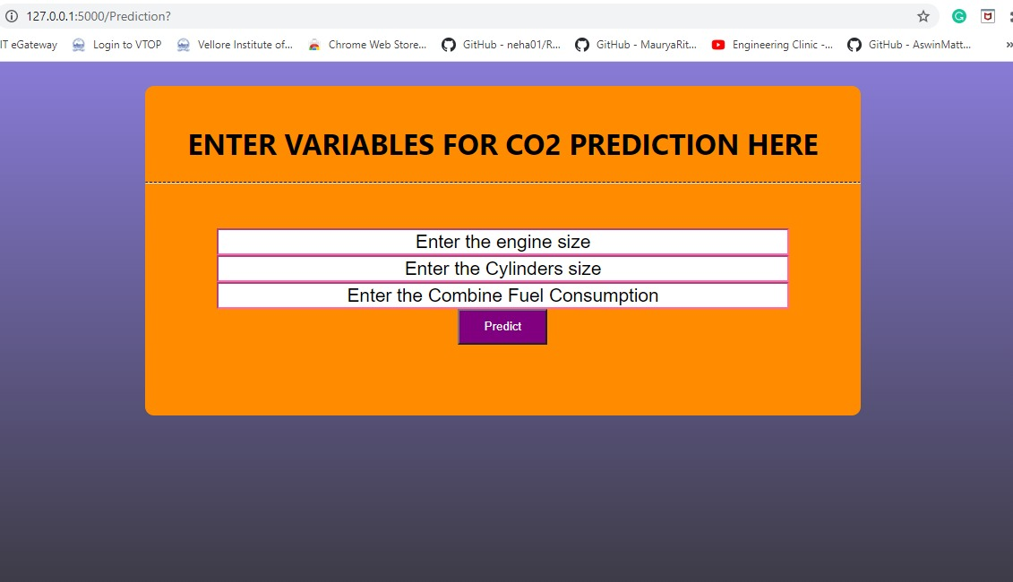

Slide 10
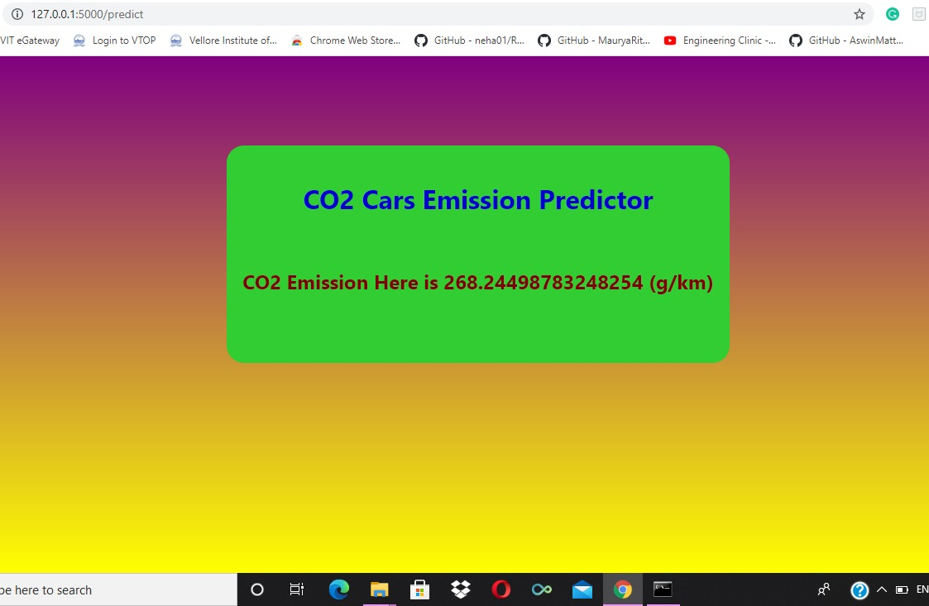

Slide 11
THANK YOU

